Slide 1
Motherson Automotive Technologies & Engineering (MATE)
Sanand, India
Proud to be part of our customers’ success
Version: August 2019

Slide 2
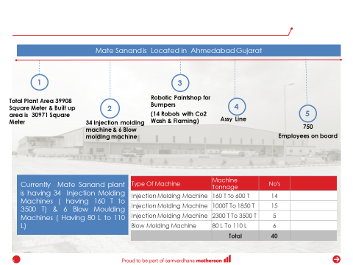
PLANT – OVERVIEW Sanand

Slide 3
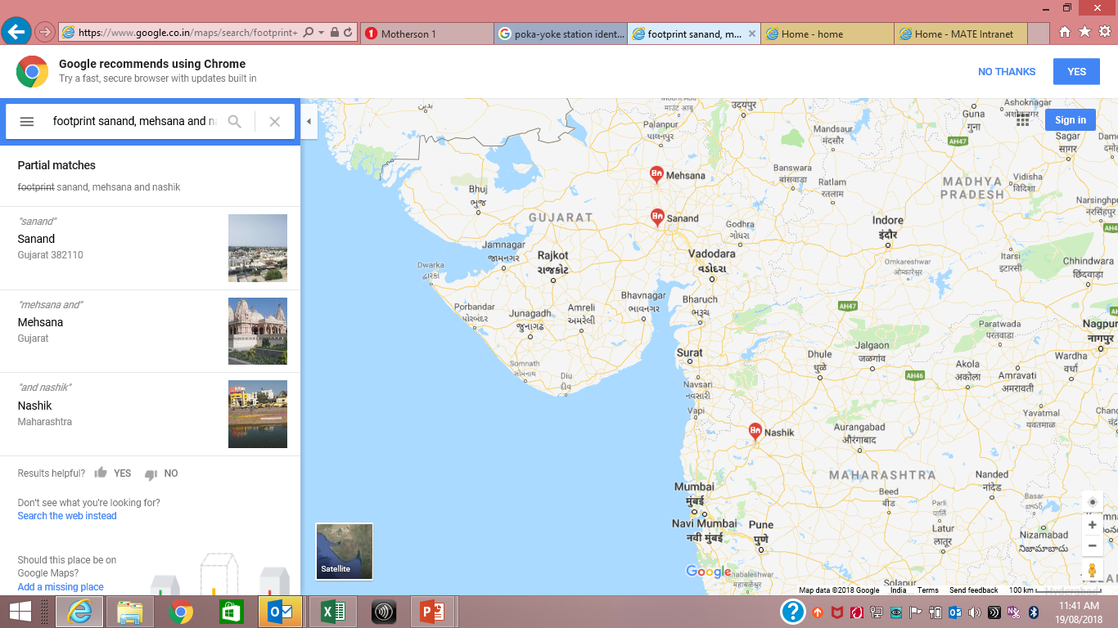
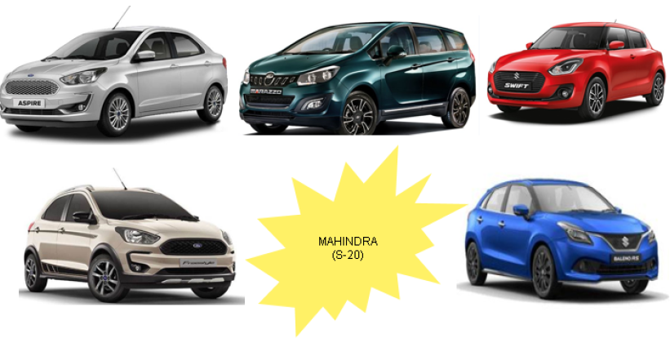


GEOGRAPHICAL FOOTPRINT – MATE SANAND & CUSTOMERS

Slide 4
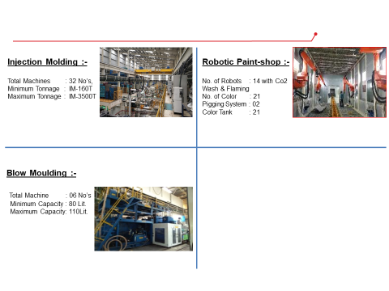
MATE SANAND FACILITIES

Slide 5
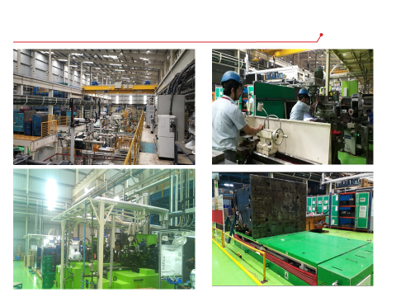
MATE SANAND (MOULDING SHOP)

Slide 6
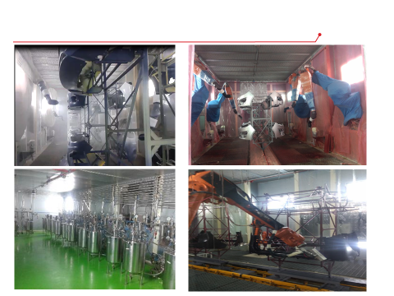
MATE SANAND (PAINTSHOP) :-

Slide 7
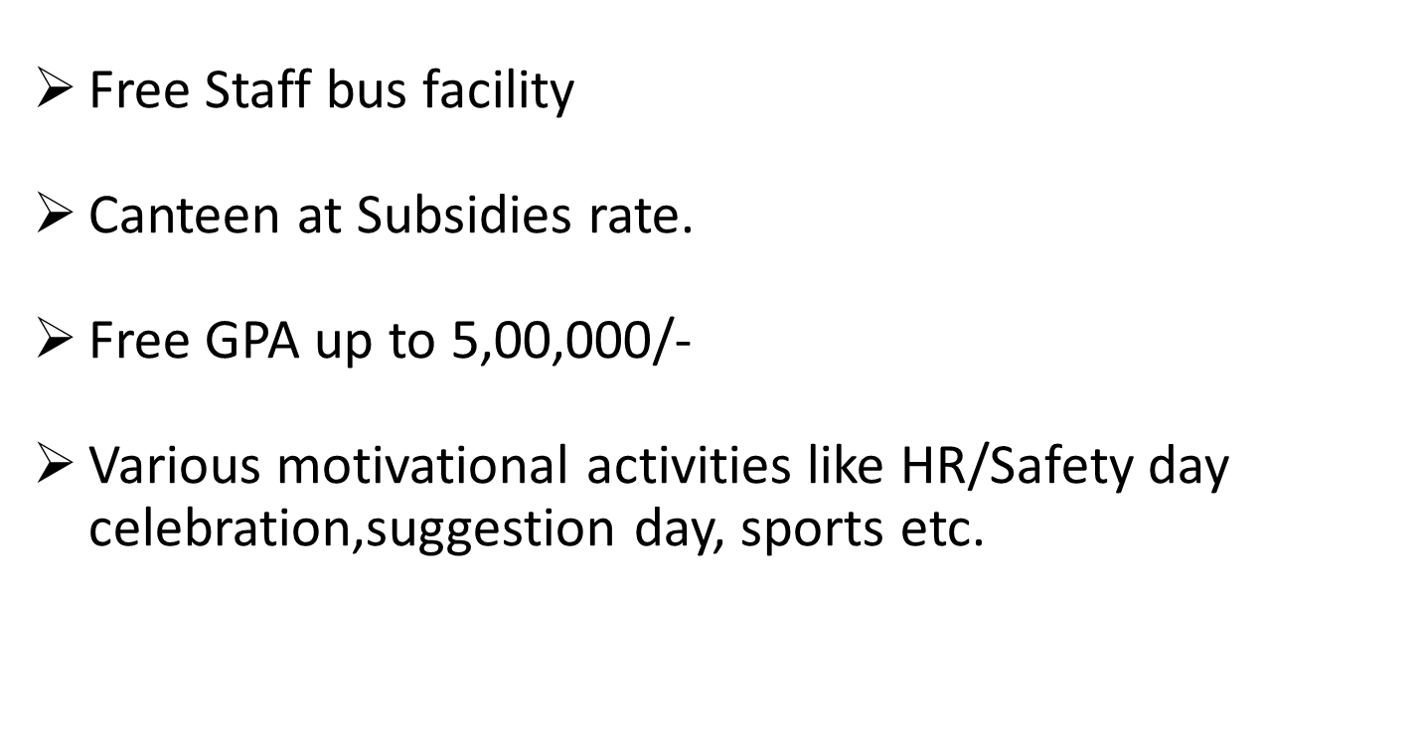
Facility at MATE Sanand

Slide 8
Rules of Hiring-Technician Trainee
Any Diploma
Selection for 24 months through exam and interview.
After 12 months can be taken on permanent roll based on performance,attendance etc.
CTC Rs.16300/- per month and
Rs 300 attendance bonus extra with no leave in a month
Accommodation in case of immediate joining –Rs.600/- will be deducted only.

Slide 9
Job profile
Responsible to operate machine –Injection moulding and Blow moulding after proper training
Ensure production target to be achieved as per the given plan
Inform to the supervisor in case of any breakdown, packing shortage, power off etc.
Responsible to update production plan/checklist.
Proper handover of his work shift wise.
Any work assign to him from time to time.

